Slide 1
Guide to Computer Forensics and Investigations
Fourth Edition
Chapter 11
Network Forensics

Slide 2
Network Forensics Overview
Network forensics
  Process of collecting and analyzing raw network data and tracking network traffic
  To ascertain how an attack was carried out or how an event occurred on a network
Intruders leave trail behind
Spot variations in network traffic(knowing typical traffic pattern is imp)
Determine the cause of the abnormal traffic
  Internal bug
  Attackers

Slide 3
The Need for Established Procedures
Network administrator want to find compromised machines, get them offline and restore them as quickly as possible to minimize downtime
Network forensics examiners must establish standard procedures for how to acquire data after an attack or intrusion
  Essential to ensure that all comprised systems have been found
Procedures must be based on an organization’s needs and complement network infrastructure
NIST created “Guide to Integrating Forensic Techniques into Incident Response” to address these needs

Slide 4
Securing a Network
Layered network defense strategy
  Sets up layers of protection to hide the most valuable data at the innermost part of the network
  More difficult access
Defense in depth (DiD)
  approach developed by the NSA
  Modes of protection
    People
    Technology
    Operations

Slide 5
Defense in depth (DiD)
  Modes of protection
    People
    Organization must hire well qualified people and treat them well so that they have no reason to seek revenge
    Employees should be trained adequately
    Technology
    Must include strong network architecture & using tested tools such as IDS & firewalls
    Regular penetrations
    Operations
    Day to day operations,updating security patches,antivirus s/w & OS

Slide 6
Securing a Network (continued)
Testing networks is as important as testing servers
You need to be up to date on the latest methods intruders use to infiltrate networks
  As well as methods internal employees use to sabotage networks

Slide 7
Performing Live Acquisitions
Live acquisitions are especially useful when you’re dealing with active network intrusions or attacks
Live acquisitions done before taking a system offline are also becoming a necessity
  Because attacks might leave footprints only in running processes or RAM
Live acquisitions don’t follow typical forensics procedures
Order of volatility (OOV)
How long a piece of information lasts on a system
Eg Ram, Running processes

Slide 8
Performing Live Acquisitions (continued)
Steps
  Create or download a bootable forensic CD
  Make sure you keep a log of all your actions
  A network drive is ideal as a place to send the information you collect(or USB drive)
  Copy the physical memory (RAM)(tools such as BackTrack/memfetch)
  The next step varies, depending on the incident you’re investigating(eg intrusion- rootkit)
  Be sure to get a forensic hash value of all files you recover during the live acquisition

Slide 9
Performing a Live Acquisition in Windows
Several tools are available to capture the RAM.
  1. Mantech Memory DD
  Can capture upto 4 gb RAM using dd format
  2. Win32dd
  Commandline tool to perform memory dump in windows
  3. winen.exe from Guidance Software
  4. BackTrack
  Contains tools like password crackers,network snifffers & freeware

Slide 10
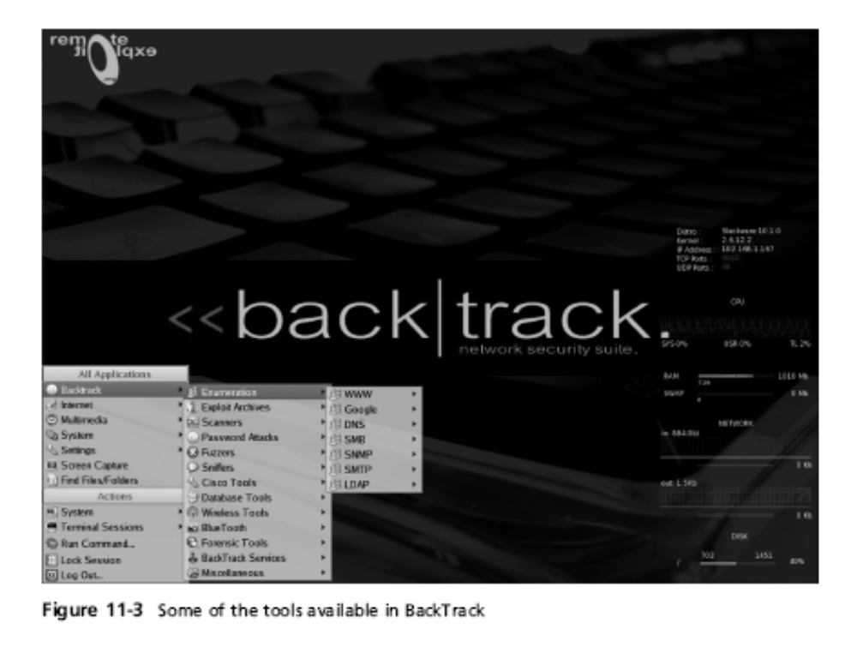
Performing a Live Acquisition in Windows

Slide 11
Developing Standard Procedures for Network Forensics
Long, tedious process & trail can go cold quickly
Standard procedure
  Always use a standard installation image for systems on a network( MD5 & SHA-1 hash values)
  Fix any vulnerability after an attack
  Attempt to retrieve all volatile data
  Acquire all compromised drives
  Compare files on the forensic image to the original installation image(compare hash values)

Slide 12
Developing Standard Procedures for Network Forensics (continued)
In digital forensics
You can work from the image to find most of the deleted or hidden files and partitions
In network forensics
You have to restore drives to understand attack
Work on an isolated system
Prevents malware from affecting other systems
  Drives can be wiped to DOD level

Slide 13
Reviewing Network Logs
Record ingoing & outgoing traffic
  Network servers
  Routers
  Firewalls
Tcpdump tool for examining network traffic
  Can generate top 10 lists
  Can generate thousands of record as well
  Can identify patterns
Attacks might include other companies
  Do not reveal information discovered about other companies

Slide 14
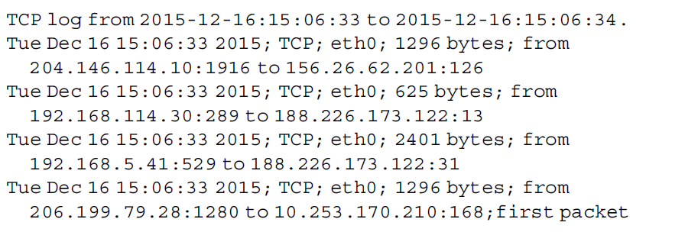
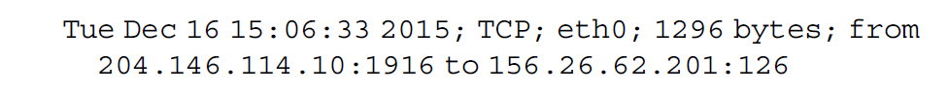
The first line of the output is simply the header. The rest of the lines follow the format time; protocol; interface; size; source and destination addresses.
Take another look at the second line from the previous output:
This line shows that data was transmitted on Tuesday, December 16, 2015, at 15:06:33. It was a TCP packet sent via the Ethernet 0 interface of 1296 bytes. The packet was sent from 204.146.114.10:1916 to 156.26.62.201:126. In these IP addresses, the numbers after the
colon represent the port number

Slide 15
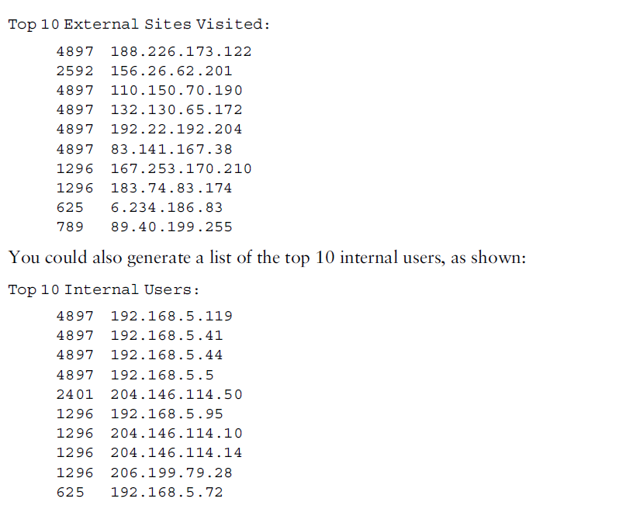
Use wire shark tool for this
Tripwire software is an audit control program that detects anomalies in traffic and sends alerts

Slide 16
Using Network Tools
Sysinternals
  A collection of free tools for examining Windows products
Examples of the Sysinternals tools:
  RegMon shows Registry data in real time(eg DLL)
  Process Explorer shows what is loaded
  Handle shows open files and processes using them
  Filemon shows file system activity
Guide to Computer Forensics and Investigations

Slide 17
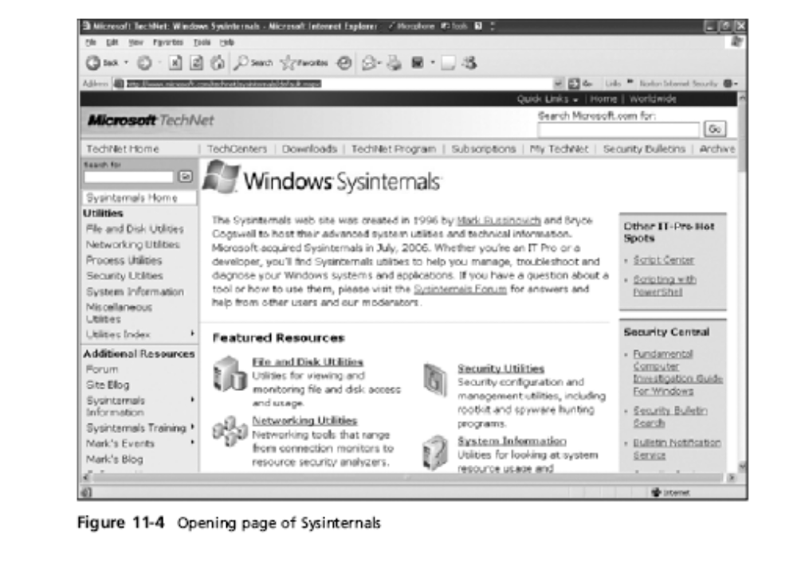
Using Network Tools (continued)
Guide to Computer Forensics and Investigations

Slide 18
Using Network Tools (continued)
Tools from PsTools suite created by Sysinternals
  PsExec runs processes remotely
  PsGetSid displays security identifier (SID)
  PsKill kills process by name or ID
  PsList lists details about a process
  PsLoggedOn shows who’s logged locally
  PsPasswd changes account passwords
  PsService controls and views services
  PsShutdown shuts down and restarts PCs
  PsSuspend suspends processes

Slide 19
Using UNIX/Linux Tools
Knoppix Security Tools Distribution (STD)
  Bootable Linux CD intended for computer and network forensics
  Includes authentication,encryption, forensics, firewalls,IDSs, honeypots etc
Knoppix-STD tools put together by Klaus Knopper
  Dcfldd,-the U.S. DoD dd version
  memfetch -forces a memory dump
  Photorec-grabs files from a digital camera
  snort,-an intrusion detection system
  Oinkmaster-helps manage your snort rules

Slide 20
Using UNIX/Linux Tools (continued)
Knoppix-STD tools (continued)
  John- password cracker
  chntpw resets passwords on a Windows PC
  tcpdump and ethereal are packet sniffers
With the Knoppix STD tools on a portable CD
  You can examine almost any network system

Slide 21
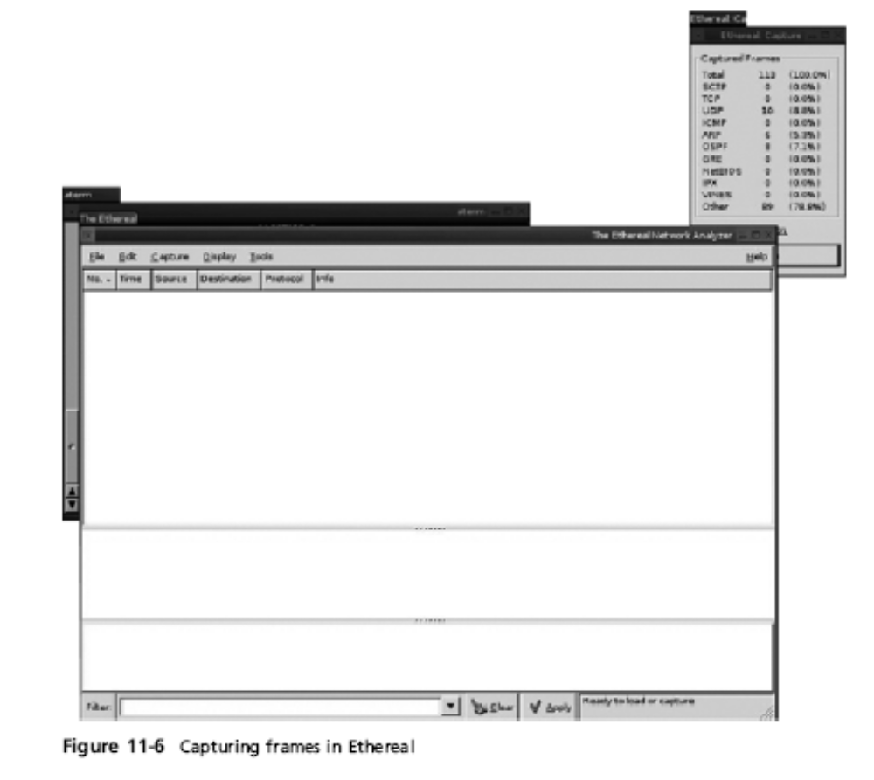

Slide 22
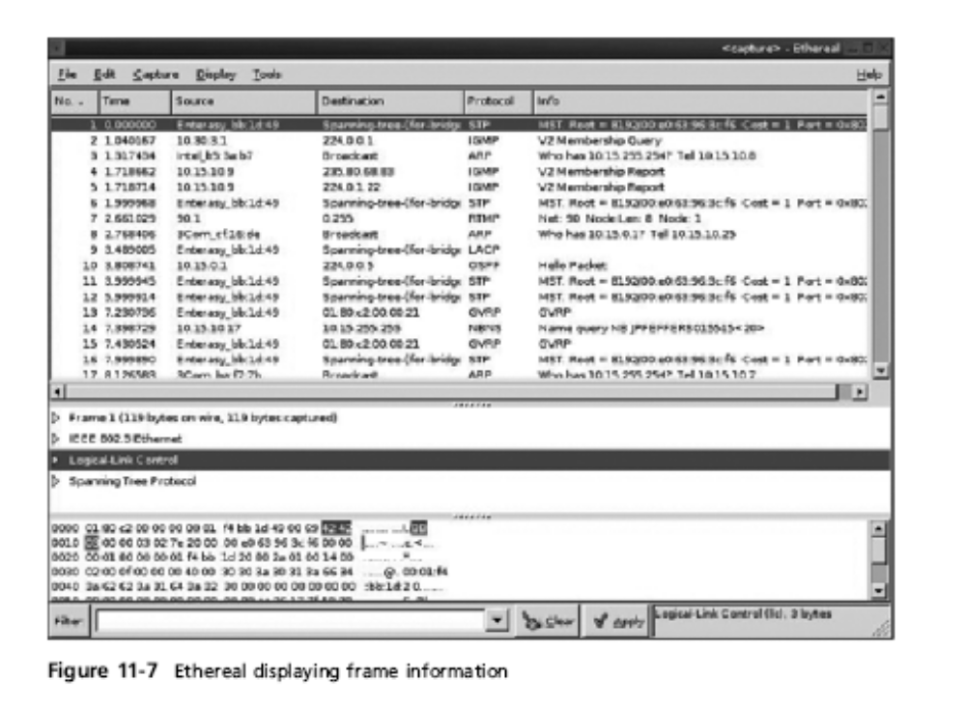
Using UNIX/Linux Tools (continued)

Slide 23
Using UNIX/Linux Tools (continued)
The Auditor
  Robust security tool whose logo is a Trojan warrior
  Replaced by BackTrack
  Based on Knoppix and contains more than 300 tools for network scanning, brute-force attacks, Bluetooth and wireless networks, and more
  Includes forensics tools, such as Autopsy and Sleuth
  Easy to use and frequently updated
Guide to Computer Forensics and Investigations

Slide 24
Using Packet Sniffers
Packet sniffers
  Devices or software that monitor network traffic
  Admins use sniffers for increasing security & tracking bottlenecks
  Most work at layer 2 or 3 of the OSI model
Most tools follow the PCAP format(packet capture format)
Some packets can be identified by examining the flags in their TCP headers
Tools
  Tcpdump
  Tethereal
  Wireshark

Slide 25
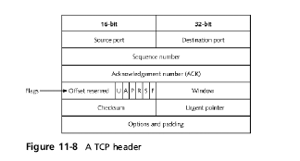
Using Packet Sniffers (continued)
Guide to Computer Forensics and Investigations

Slide 26
Using Packet Sniffers (continued)
Tools (continued)
  Snort(examine tcp header for flags)
  Tcpslice(extracting info from a particular time frame)
  Tcpreplay((replay network traffic)
  Tcpdstat(to generate stats & break packets)
  Ngrep(examine email headers)
  Etherape(view network traffic graphically)
  Netdude(GUI tool for inspecting analyzing files)
  ArguS(analysis tool)
Guide to Computer Forensics and Investigations

Slide 27
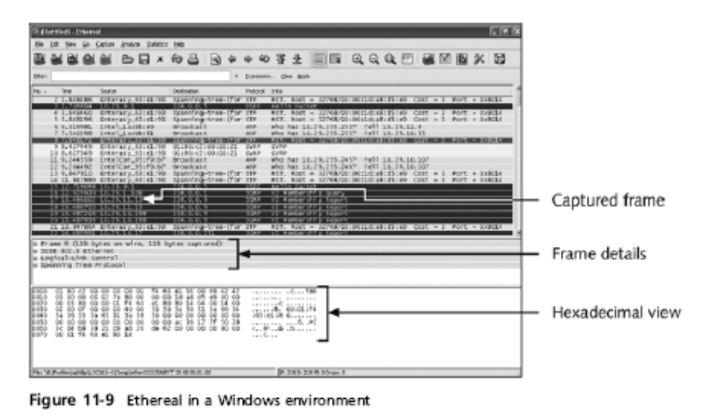
Using Packet Sniffers (continued)
Guide to Computer Forensics and Investigations

Slide 28
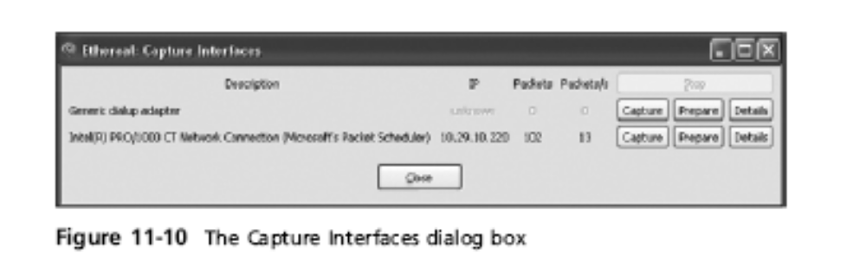
Using Packet Sniffers (continued)
Guide to Computer Forensics and Investigations

Slide 29
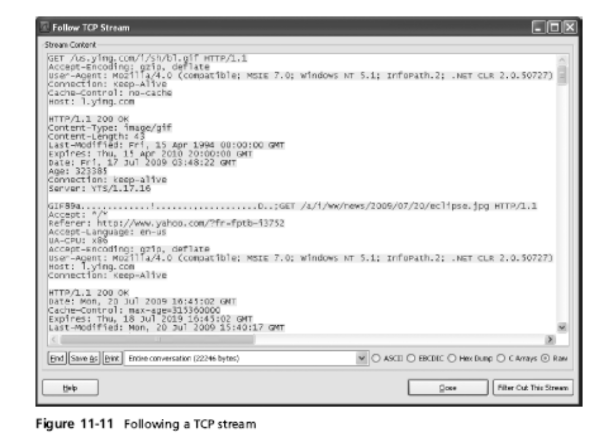
Using Packet Sniffers (continued)
Guide to Computer Forensics and Investigations

Slide 30
Examining the Honeynet Project
The Honeynet Project was developed to make information widely available in an attempt to thwart Internet and network hackers
  Objectives are awareness, information, and tools
Distributed denial-of-service (DDoS) attacks
  Hundreds or even thousands of machines (zombies) can be used
Zero day attacks
  Another major threat
  Attackers look for holes in networks and OSs and exploit these weaknesses before patches are available
Honeypot
  Normal looking computer that lures attackers to it
Honeywalls
  Monitor what’s happening to honeypots on your network and record what attackers are doing
Honey stick
Contains honeywall and honeypot on a bootable memory stick

Slide 31
Summary
Virtual machines are important in today’s networks, and investigators must know how to detect a virtual machine installed on a host, acquire an image of a virtual machine, and use virtual machines to examine malware
Network forensics tracks down internal and external network intrusions
Networks must be hardened by applying layered defense strategies to the network architecture
Live acquisitions are necessary to retrieve volatile items
Guide to Computer Forensics and Investigations

Slide 32
Summary (continued)
Standard procedures need to be established for how to proceed after a network security event has occurred
By tracking network logs, you can become familiar with the normal traffic pattern on your network
Network tools can monitor traffic on your network, but they can also be used by intruders
Bootable Linux CDs, such as Knoppix STD and Helix, can be used to examine Linux and Windows systems
Guide to Computer Forensics and Investigations

Slide 33
Summary (continued)
The Honeynet Project is designed to help people learn the latest intrusion techniques that attackers are using

